Slide 1
24
7
30
Date
Pythagoras Theorem
EQ – What are the conditions needed to use Pythagoras’ Theorem ?

Slide 2
What is a right triangle?
Topic: Pythagoras’ Theorem EQ: What are the conditions needed to use Pythagoras’ Theorem?
hypotenuse
leg
right angle
leg
It is a triangle which has an angle that is 90 degrees.
The two sides that make up the right angle are called legs.
The side opposite the right angle is the hypotenuse.

Slide 3
Topic: Pythagoras’ Theorem EQ: What are the conditions needed to use Pythagoras’ Theorem?
The lengths of the two shorter sides are the legs
a
b

Slide 4
Topic: Pythagoras’ Theorem EQ: What are the conditions needed to use Pythagoras’ Theorem?
The side across from the right angle is called the:
hypotenuse
a
b

Slide 5
Topic: Pythagoras’ Theorem EQ: What are the conditions needed to use Pythagoras’ Theorem?
The relationship Pythagorus discovered is now called The Pythagorean Theorem:
c
a
b

Slide 6
Topic: Pythagoras’ Theorem EQ: What are the conditions needed to use Pythagoras’ Theorem?
The Pythagorean Theorem says, given the right triangle with legs a and b and hypotenuse c,
c
a
b

Slide 7
Topic: Pythagoras’ Theorem EQ: What are the conditions needed to use Pythagoras’ Theorem?
then
c
a
b

Slide 8





Topic: Pythagoras’ Theorem EQ: What are the conditions needed to use Pythagoras’ Theorem?
Pythagoras Theorem is about right angles triangles.
$c$
$a$
$b$
$$a^{2}+ b^{2}= c^{2}$$
Therefore to find the shorter sides (legs):
$${ a}^{2}=c^{2}−b^{2} and b^{2}=c^{2}−a^{2}$$
$a= \sqrt{c^{2}− b^{2} }$
$$b=\sqrt{c^{2}− a^{2}}$$
$$c=\sqrt{a^{2}+ b^{2}}$$

Slide 9


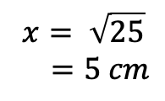
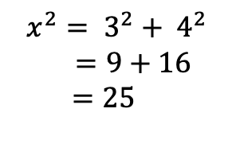

Examples
Topic: Pythagoras’ Theorem EQ: What are the conditions needed to use Pythagoras’ Theorem?
$$x$$
$$3 cm$$
$$4 cm$$
$$x^{2}= 3^{2}+ 4^{2}$$
$=9+16$
$$=25$$
$$x= \sqrt{25}$$
$=5 cm$

Slide 10


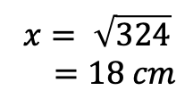
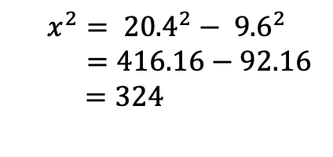
Examples
Topic: Pythagoras’ Theorem EQ: What are the conditions needed to use Pythagoras’ Theorem?
$$9.6 cm$$
$$x$$
$$x^{2}= {20.4}^{2}− {9.6}^{2}$$
$=416.16−92.16$
$$=324$$
$$20.4 cm$$
$$x= \sqrt{324}$$
$=18 cm$
Now you try the following questions:

Slide 11
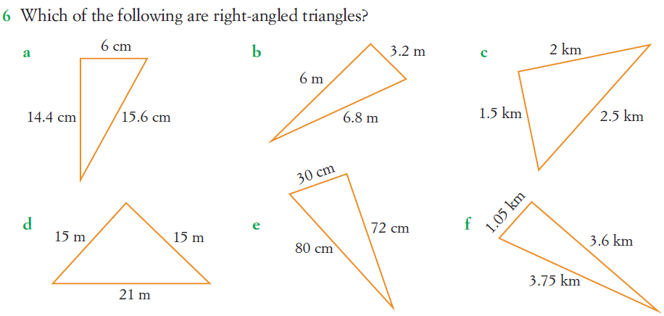
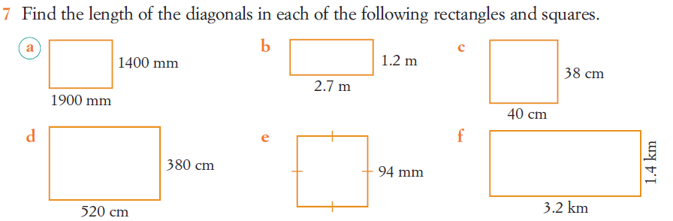
Topic: Pythagoras’ Theorem EQ: What are the conditions needed to use Pythagoras’ Theorem?

Slide 12
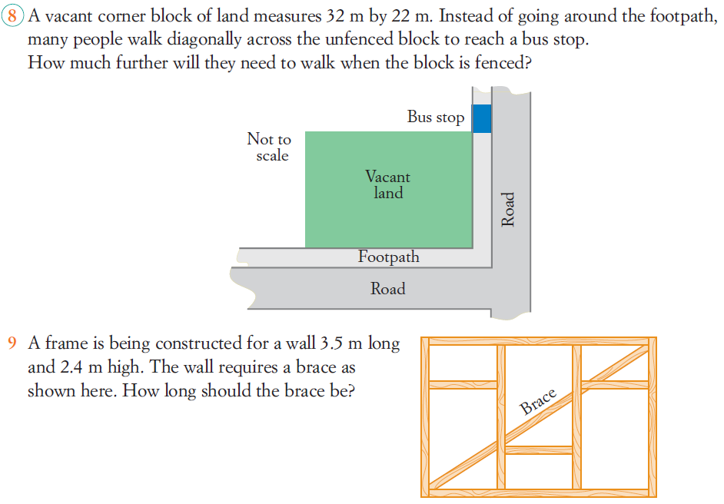
Topic: Pythagoras’ Theorem EQ: What are the conditions needed to use Pythagoras’ Theorem?

Slide 13
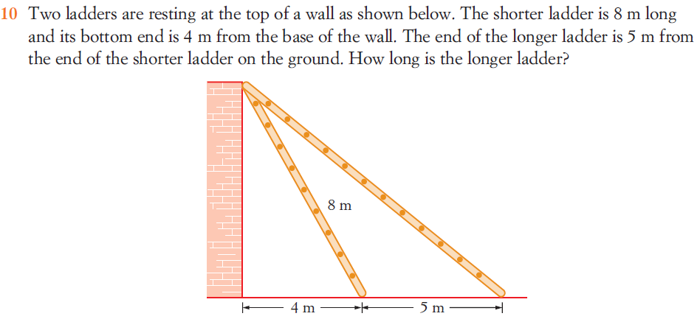
Topic: Pythagoras’ Theorem EQ: What are the conditions needed to use Pythagoras’ Theorem?

Slide 14
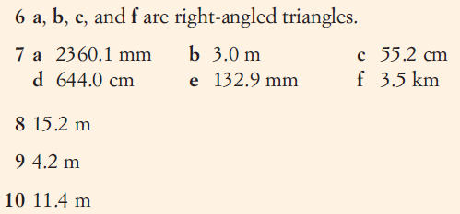

Topic: Pythagoras’ Theorem EQ: What are the conditions needed to use Pythagoras’ Theorem?

Slide 15
Topic: Pythagoras’ Theorem EQ: What are the conditions needed to use Pythagoras’ Theorem?
Complete summary
Complete Freefall Pythagoras - Problems Worksheet

